Slide 1



MERN – ES6 + React
Module 10: DOM Application

Slide 2
Outline
Module 10
DOM Model Application
Understanding of methods myvariable.style.color
Understanding of methods myvariable.textContent
Understanding of methods myvariable.innerHTML
Understanding of methods myvariable.getAttribute()
Understanding of methods myvariable.setAttribute()

Slide 3

Document Object Model

Slide 4
In this section we will learn about the Document Object Model (DOM)
The DOM will allow us to interface our Javascript code to interact with HTML and CSS

Slide 5
Browsers will construct the DOM, which basically means storing all the HTML tags as Javascript objects.
Let’s see a simple example...

Slide 6
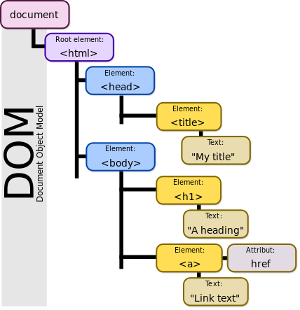
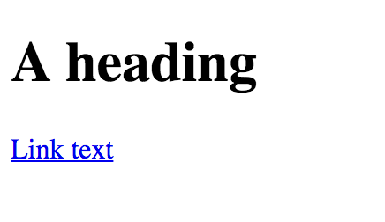
<! DOCTYPE html>
<html>
<head>
<title> My Title </title>
</head>
<body>
<h1>A heading </h1>
<a href= “websiteLink”>Link text</a>
</body>

Slide 7
We can see the DOM of any website.
Go to a website and in the console type:
document
That will return the HTML text of the page. To see the actual objects use:
console.dir(document)

Slide 8
This DOM will allow us to use Javascript to interact with the web page.
The DOM is enormous, most developers won’t use all the properties.
We will cover the common objects used, but be prepared for the unknown!

Slide 9
Let’s explore this in the browser!
Afterwards in the next lecture we will go through an example of using Javascript with the DOM.

Slide 10
Part 1 -DOM Interaction
Using Javascript to interact with DOM elements!

Slide 11
In this lecture we will begin to see examples of how to grab HTML elements from the DOM.
The HTML elements are properties of the DOM

Slide 12
We’ll cover how to grab large groups of elements, like the entire body or head of the HTML
And then focus on grabbing specific HTML items, like classes or ids.

Slide 13
Here are some important document attributes:
document.URL
document.body
document.head
document.links

Slide 14
There are many methods for grabbing elements from the DOM:
document.getElementById()
document.getElementByClassName()
document.getElementsByTagName()
document.querySelector()
document.querySelectorAll()

Slide 15
Check out the relevant files:
Part1_MainPage.html
Part1_Color_Changer.js
We will start by disconnecting the html file and exploring it a bit manually, then we will code out a complex example.

Slide 16
Let’s explore these various methods!

Slide 17
Once you have grabbed an element, you can interact with it!
myvariable.style.color (Many CSS options)
myvariable.textContent
myvariable.innerHTML
myvariable.getAttribute()
myvariable.setAttribute()

Slide 18
Part 2 - Content Interaction
Document Object Model

Slide 19
In this lecture we will see more examples of how to interact with the HTML from the DOM.
We will show how to change text, HTML code, and attributes.

Slide 20
Relevant files are:
Part2_Content.html
Part2_Interact.js
Let’s get started!

Slide 21
Part 3 - DOM Events
Using Javascript to trigger on events!

Slide 22
We don’t always want to have to specify beforehand how to interact with the DOM
Many times we only want the interaction to occur on a particular event, such as a click or a hover.

Slide 23
We achieve this by adding an Event Listener
The javascript will be “listening” for an event to occur and then execute a function when it happens.
Let see some example code!

Slide 24
Listening for an event looks like this:
myvariable.addEventListener(event,func);
An example:
var head = document.querySelector(‘h1’);
head.addEventListener(“click”,changeColor);

Slide 25
There are many, many possible events!
Clicks
Hovers
Double Clicks
Drags
Much More!
https://developer.mozilla.org/en-US/docs/Web/Events

Slide 26
Summary
Module 10
DOM Model Application
Understanding of methods myvariable.style.color
Understanding of methods myvariable.textContent
Understanding of methods myvariable.innerHTML
Understanding of methods myvariable.getAttribute()
Understanding of methods myvariable.setAttribute()

